Slide 1

Tower Defense Game C++ / Glut
By Martyn van Dijke
Computation II

Slide 2
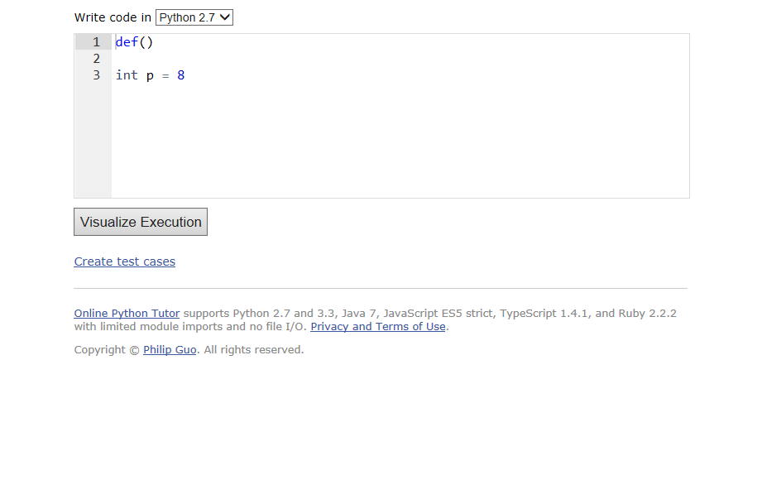
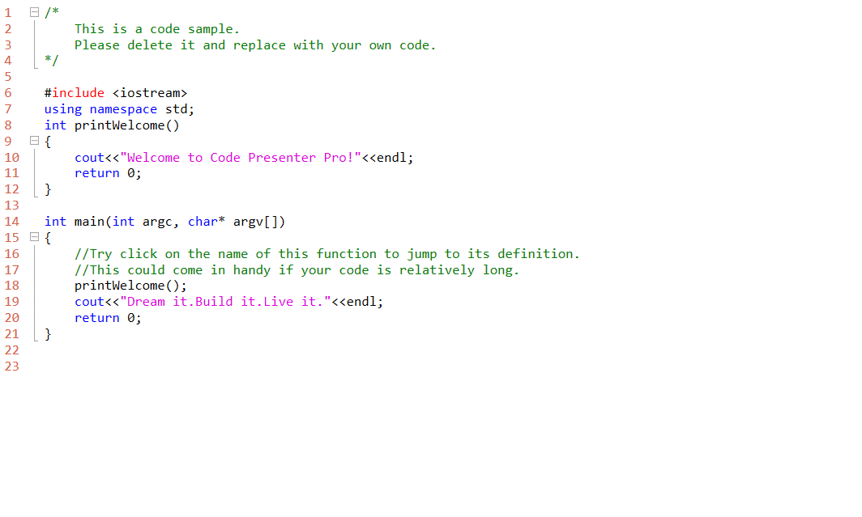

Slide 3


